Slide 1
Do deep nets really
need to be deep?
Rich Caruana
Microsoft Research
Lei Jimmy Ba
MSR Intern, University of Toronto
Thanks also to: Gregor Urban, Krzysztof Geras, Samira Kahou, Abdelrahman Mohamed, Jinyu Li, Rui Zhao, Jui-Ting Huang, and Yifan Gong

Slide 2
Yes!
Thank You
Any Questions?

Slide 3
Shallow, deep, and deeper
CNN: Three Hidden Layers above
Convolutional/MaxPooling Layers
DNN: Three Hidden Layers
Outputs
Outputs
SNN: Single Hidden Layer
Outputs
Inputs
Inputs
Inputs

Slide 4
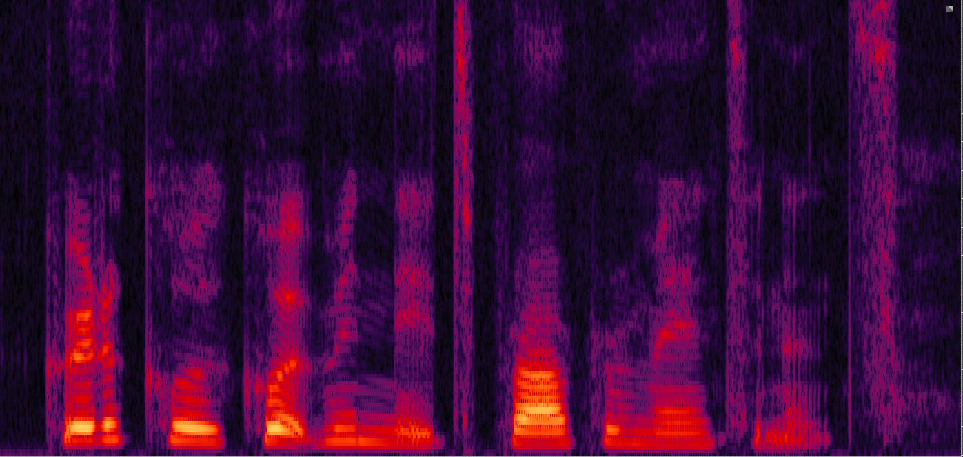
Speech Recognition with deep learning
TIMIT (Texas Instruments + MIT) ASR benchmark corpus
25-ms hamming window with 40 filter-bank coefficients
1845-d input vectors
183-d target vectors
train = 462 speakers; dev = 50; test = 24
final train set:
1.1 million frames

Slide 5
Speech Recognition with deep learning
Progress on TIMIT over years:
Bayesian HMM (1998)
25.6% triphone 24.8% monophone

Slide 6
Speech Recognition with deep learning
Progress on TIMIT over years:
Bayesian HMM (1998)
25.6% triphone 24.8% monophone
record stood for 10 years!

Slide 7
Speech Recognition with deep learning
Progress on TIMIT over years:
Bayesian HMM (1998) | HMM-DNN (2009) | HMM-DNN +dropout (2012) | HMM-CNN (2013) | Deep Recurrent Neural Net (2013)
25.6% triphone 24.8% monophone | 23.0% | 19.8% | 18.7% | 17.7%
record stood for 10 years!

Slide 8
The “Miracle” of Deep Learning
From 2005-2015:
+5% accuracy on TIMIT
Similar increases in accuracy on real speech recognition data
>+25% accuracy on image classification (near human level accuracy?)
Results on text/NLP and genomics data look promising, too
Works well with raw inputs: pixels, raw speech, …
Learns interesting internal representations for images and NLP
Works particularly well when convolution helps
Works well with many outputs (multitask learning)
Models keep getting bigger and deeper
State of the art seems to advance every month
Need big data, a lot of GPUs, and expensive hyper-parameter optimization to make it work well

Slide 9
What do you need to make deep learning work?
Need large data:
50k - 100k = small (CIFAR-10)
100k - 1M = moderate (TIMIT)
10M - 100M = large (CIFAR-10 with augmentations)
100M - 1B+ = very large (1000hr speech data)
Need GPUs:
Speed up learning 10x-1000x
1hr - 12hrs = fast run (CIFAR-10)
12hrs - 1day = typical short run (CIFAR-100, TIMIT)
1day-1week = typical long run (Switchboard 300hr speech data)
1week-1month = long run (ImageNet, large speech data, …)
Need hyper-parameter optimization:
Larger nets =>
More hyper-parameters =>
More sensitivity to hyper-parameters =>
More critical and expensive optimization => more GPUs!

Slide 10
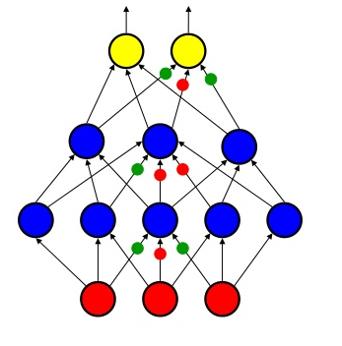
Why does deep learning work?

Slide 11
Why does deep learning work?
Deep provides exponential increase in representational power without adding too many parameters?

Slide 12
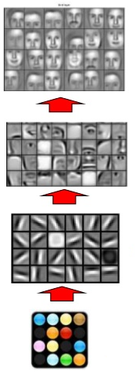
Why does deep learning work?
Deep provides exponential increase in representational power without adding too many parameters?
Learning hierarchy of features is important?

Slide 13
Why does deep learning work?
Deep provides exponential increase in representational power without adding too many parameters?
Learning hierarchy of features is important?
Deep nets work better with current training algorithms, initialization/pre-training, and regularization procedures

Slide 14
Why does deep learning work?
Deep provides exponential increase in representational power without adding too many parameters?
Learning hierarchy of features is important?
Deep nets work better with current training algorithms, initialization/pre-training, and regularization procedures
All of the above?

Slide 15
Why does deep learning work?
Deep provides exponential increase in representational power without adding too many parameters?
Learning hierarchy of features is important?
Deep nets work better with current training algorithms, initialization/pre-training, and regularization procedures
All of the above?
None of the above?

Slide 16
Goal of this work:
Try to find answers to why deep learning works so well
Don’t have all of the answers yet…
…but we have some very interesting results…

Slide 17
Goal of this work:
Try to find answers to why deep learning works so well
Don’t have all of the answers yet…
…but we have some very interesting results…
NOT trying to replace deep neural nets with shallow 1-layer nets

Slide 18
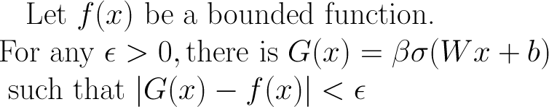
Do Deep Models Really Need to Be Deep? Universal function approximation theorem says...
For as few as one hidden layer, neural networks are capable of approximating any bounded function
It is a theory about representation, not what’s learnable…
Given kinds of functions we need to learn from real data, do deep nets provide advantage over shallow nets given same number of parameters?
Notes:
As the \epsilon goes to 0, the number hidden units in the weighted sum will go to \infinity

Slide 19
Our experimental results say...
With our method (SNN++), shallow neural networks
sometimes perform as well as deep models:
Note: we did not tune language model during decoding so more accuracy is possible
new
Model | SNN | DNN 3 layers | CNN conv + 3 layers | SNN++
TIMIT Core Test Phone-Error-Rate | 23.6% | 21.6% | 19.5% | 21.8% 19.5%

Slide 20
How did we train a 1-layer Shallow NN to be as accurate as a state-of-the-art Deep NN/Conv NN!?
Model Compression
Speed-up SNN learning via re-parameterization
Ensembles of CNNs

Slide 21
How did we train a 1-layer Shallow NN to be as accurate as a state-of-the-art Deep NN/Conv NN!?
Model Compression
Speed-up SNN learning via re-parameterization
Ensembles of CNNs

Slide 22
Model Compression (circa 2005)
Rich Caruana
Cornell University
joint with Cristi Bucila and Alex Niculescu-Mizil

Slide 23
Summary of Large Empirical ML Study
 |  | Threshold Metrics |  |  | Rank/Ordering Metrics |  |  | Probability Metrics
Model | Cal | Accuracy | F-Score | Lift | ROC Area | Average Precision | Break Even Point | Squared Error | Cross-Entropy | Mean
BOOST-DT | PLT | .843 | .779 | .939 | .963 | .938 | .929 | .880 | .896 | .896
RAND-FOR | PLT | .872 | .805 | .934 | .957 | .931 | .930 | .851 | .858 | .892
BAG-DT | * | .846 | .781 | .938 | .962 | .937 | .918 | .845 | .872 | .887
SVM | PLT | .824 | .760 | .895 | .938 | .898 | .913 | .831 | .836 | .862
ANN | * | .803 | .762 | .910 | .936 | .892 | .899 | .811 | .821 | .854
KNN | PLT | .757 | .707 | .889 | .918 | .872 | .872 | .742 | .764 | .815
BOOST-STMP | PLT | .724 | .651 | .876 | .908 | .853 | .845 | .716 | .754 | .791
DT | ISO | .648 | .654 | .818 | .838 | .756 | .778 | .590 | .589 | .709
LOG-REG | * | .636 | .545 | .823 | .852 | .743 | .734 | .620 | .645 | .700
NAÏVE-B | ISO | .579 | .468 | .779 | .820 | .727 | .733 | .572 | .555 | .654

Slide 24
Surprise #1
 |  | Threshold Metrics |  |  | Rank/Ordering Metrics |  |  | Probability Metrics
Model | Cal | Accuracy | F-Score | Lift | ROC Area | Average Precision | Break Even Point | Squared Error | Cross-Entropy | Mean
BEST |  | .928 | .918 | .975 | .987 | .958 | .958 | .919 | .989 | .954
BOOST-DT | PLT | .843 | .779 | .939 | .963 | .938 | .929 | .880 | .896 | .896
RAND-FOR | PLT | .872 | .805 | .934 | .957 | .931 | .930 | .851 | .858 | .892
BAG-DT | * | .846 | .781 | .938 | .962 | .937 | .918 | .845 | .872 | .887
SVM | PLT | .824 | .760 | .895 | .938 | .898 | .913 | .831 | .836 | .862
ANN | * | .803 | .762 | .910 | .936 | .892 | .899 | .811 | .821 | .854
KNN | PLT | .757 | .707 | .889 | .918 | .872 | .872 | .742 | .764 | .815
BOOST-STMP | PLT | .724 | .651 | .876 | .908 | .853 | .845 | .716 | .754 | .791
DT | ISO | .648 | .654 | .818 | .838 | .756 | .778 | .590 | .589 | .709
LOG-REG | * | .636 | .545 | .823 | .852 | .743 | .734 | .620 | .645 | .700
NAÏVE-B | ISO | .579 | .468 | .779 | .820 | .727 | .733 | .572 | .555 | .654

Slide 25
Surprise #2
 |  | Threshold Metrics |  |  | Rank/Ordering Metrics |  |  | Probability Metrics
Model | Cal | Accuracy | F-Score | Lift | ROC Area | Average Precision | Break Even Point | Squared Error | Cross-Entropy | Mean
ENSEM-SEL |  | .956 | .944 | .992 | .997 | .985 | .979 | .980 | .981 | .977
BEST |  | .928 | .918 | .975 | .987 | .958 | .958 | .919 | .989 | .954
BOOST-DT | PLT | .843 | .779 | .939 | .963 | .938 | .929 | .880 | .896 | .896
RAND-FOR | PLT | .872 | .805 | .934 | .957 | .931 | .930 | .851 | .858 | .892
BAG-DT | * | .846 | .781 | .938 | .962 | .937 | .918 | .845 | .872 | .887
SVM | PLT | .824 | .760 | .895 | .938 | .898 | .913 | .831 | .836 | .862
ANN | * | .803 | .762 | .910 | .936 | .892 | .899 | .811 | .821 | .854
KNN | PLT | .757 | .707 | .889 | .918 | .872 | .872 | .742 | .764 | .815
BOOST-STMP | PLT | .724 | .651 | .876 | .908 | .853 | .845 | .716 | .754 | .791
DT | ISO | .648 | .654 | .818 | .838 | .756 | .778 | .590 | .589 | .709
LOG-REG | * | .636 | .545 | .823 | .852 | .743 | .734 | .620 | .645 | .700
NAÏVE-B | ISO | .579 | .468 | .779 | .820 | .727 | .733 | .572 | .555 | .654

Slide 26
Interesting Surprise #2
 |  | Threshold Metrics |  |  | Rank/Ordering Metrics |  |  | Probability Metrics
Model | Cal | Accuracy | F-Score | Lift | ROC Area | Average Precision | Break Even Point | Squared Error | Cross-Entropy | Mean
BAYES-AVG |  | .926 | .891 | .979 | .985 | .977 | .956 | .950 | .987 | .956
BEST |  | .928 | .918 | .975 | .987 | .958 | .958 | .919 | .989 | .954
AVG-ALL |  | .836 | .801 | .982 | .988 | .972 | .961 | .827 | .809 | .897
STACKING |  | .275 | .777 | .835 | .799 | .786 | .847 | .332 | -.989 | .458
BOOST-DT | PLT | .843 | .779 | .939 | .963 | .938 | .929 | .880 | .896 | .896
RAND-FOR | PLT | .872 | .805 | .934 | .957 | .931 | .930 | .851 | .858 | .892
BAG-DT | * | .846 | .781 | .938 | .962 | .937 | .918 | .845 | .872 | .887
SVM | PLT | .824 | .760 | .895 | .938 | .898 | .913 | .831 | .836 | .862
ANN | * | .803 | .762 | .910 | .936 | .892 | .899 | .811 | .821 | .854
KNN | PLT | .757 | .707 | .889 | .918 | .872 | .872 | .742 | .764 | .815

Slide 27
Turns out it’s difficult to form a weighted ensemble of highly correlated models without overfitting… Need new method: Ensemble Selection

Slide 28
Basic Ensemble Selection Algorithm
Model Library
Ensemble
Model 1
Model 2
Model 3
Model 4
Model 5
Model 6
Model 7
Model 8
Model 9

Slide 29
Basic Ensemble Selection Algorithm
Model Library
AUC Score on the 1k validation set
Ensemble
Model 1
0.8453
Model 2
0.8726
Model 3
0.9164
Model 4
0.8142
Model 5
0.8453
Model 6
0.8745
Model 7
0.9024
Model 8
0.7034
Model 9
0.8342

Slide 30
Basic Ensemble Selection Algorithm
Model Library
AUC Score on the 1k validation set
Ensemble
Model 1
0.8453
Model 2
0.8726
Model 3
0.9164
Model 4
0.8142
Model 5
0.8453
Model 6
0.8745
Model 7
0.9024
Model 8
0.7034
Model 9
0.8342

Slide 31
Basic Ensemble Selection Algorithm
Model Library
Ensemble
Model 1
Model 3
0.9164
Model 2
Model 4
Model 5
Model 6
Model 7
Model 8
Model 9

Slide 32
Basic Ensemble Selection Algorithm
Model Library
AUC Score on the 1k validation set
Ensemble
Model 1
0.8327
0.8453
Model 3
0.9164
Model 2
0.8702
0.8726
Model 4
0.9284
0.8142
Model 5
+ Ensemble =
0.9047
0.8453
Model 6
0.8832
0.8745
Model 7
0.9126
0.9024
Model 8
0.8245
0.7034
Model 9
0.9384
0.8342

Slide 33
Basic Ensemble Selection Algorithm
Model Library
AUC Score on the 1k validation set
Ensemble
Model 1
0.8327
Model 3
0.9164
Model 2
0.8702
Model 4
0.9284
Model 5
+ Ensemble =
0.9047
Model 6
0.8832
Model 7
0.9126
Model 8
0.8245
Model 9
0.9384

Slide 34
Basic Ensemble Selection Algorithm
Model Library
Ensemble
Model 1
Model 3
0.9164
Model 2
Model 9
0.9384
Model 4
Model 5
Model 6
Model 7
Model 8

Slide 35
Basic Ensemble Selection Algorithm
Model Library
AUC Score on the 1k validation set
Ensemble
Model 1
0.8502
0.8327
Model 3
0.9164
Model 2
0.9243
0.8702
Model 9
0.9384
Model 4
0.8992
0.9284
Model 5
+ Ensemble =
0.8090
0.9047
Model 6
0.9424
0.8832
Model 7
0.9045
0.9126
Model 8
0.9243
0.8245

Slide 36
Basic Ensemble Selection Algorithm
Model Library
AUC Score on the 1k validation set
Ensemble
Model 1
0.8502
Model 3
0.9164
Model 2
0.9243
Model 9
0.9384
Model 4
0.8992
Model 5
+ Ensemble =
0.8090
Model 6
0.9424
Model 7
0.9045
Model 8
0.9243

Slide 37
Basic Ensemble Selection Algorithm
Model Library
Ensemble
Model 1
Model 3
0.9164
Model 2
Model 9
0.9384
Model 6
0.9424
Model 4
Model 5
Model 7
Model 8

Slide 38
Big Problem: Overfitting
More models ==> better chance of finding good combination, but also better chance of overfitting to hillclimb set
Tricks to Reduce Overfitting:
Eliminate Inferior Models: prevents mistakes
Ensemble Initialization: give “inertia” to initial ensemble
Stepwise Selection with Replacement: stopping point less critical
Calibrate Models in Ensemble: all models speak same language
Bagged Ensemble Selection: reduces variance
Critical to take steps to reduce overfitting

Slide 39
Interesting Surprise #3
 |  | Threshold Metrics |  |  | Rank/Ordering Metrics |  |  | Probability Metrics
Model | Cal | Accuracy | F-Score | Lift | ROC Area | Average Precision | Break Even Point | Squared Error | Cross-Entropy | Mean
ENSEL-SEL |  | .956 | .944 | .992 | .997 | .985 | .979 | .980 | .981 | .977
BAYES-AVG |  | .926 | .891 | .979 | .985 | .977 | .956 | .950 | .987 | .956
BEST |  | .928 | .918 | .975 | .987 | .958 | .958 | .919 | .989 | .954
AVG-ALL |  | .836 | .801 | .982 | .988 | .972 | .961 | .827 | .809 | .897
STACKING |  | .275 | .777 | .835 | .799 | .786 | .847 | .332 | -.989 | .458
BOOST-DT | PLT | .843 | .779 | .939 | .963 | .938 | .929 | .880 | .896 | .896
RAND-FOR | PLT | .872 | .805 | .934 | .957 | .931 | .930 | .851 | .858 | .892
BAG-DT | * | .846 | .781 | .938 | .962 | .937 | .918 | .845 | .872 | .887
SVM | PLT | .824 | .760 | .895 | .938 | .898 | .913 | .831 | .836 | .862
ANN | * | .803 | .762 | .910 | .936 | .892 | .899 | .811 | .821 | .854
KNN | PLT | .757 | .707 | .889 | .918 | .872 | .872 | .742 | .764 | .815

Slide 40
BIG Problem
Best ensemble for a typical problem had 422 models:
72 boosted trees (28,642 decision trees)
1 random forest (1024 decision trees)
5 bagged trees (100 decision trees in each model)
44 neural nets (2,200 hidden units total, >100,000 weights)
115 knn models (both large and expensive!)
38 SVMs (100’s of support vectors in each model)
26 boosted stump models (36,184 stumps total -- could compress)
122 individual decision trees
…
~1/2 - 10 GB memory
~1/2 - 10 seconds to execute per test case!

Slide 41
This Really is a BIG Problem
Web search:
50-100 msec latency, 1 B queries per day
Image/face/cat recognition:
scan many sub-images at various scales
video makes things 30fps worse!
Satellites, Mars rovers, …
small hardened memory, low power, low processor speed (ancient processors)
Hearing aids
low power, small memory, slow processor
Cameras:
Real-time decision making for focus (10 msec max latency)
Smart phones
interesting case because of wireless connectivity…

Slide 42
Solution: Model Compression
Train complex model any way you want:
ensemble
very big deep neural net
ensemble of DNNs
Train simpler model to mimic the complex model/ensemble
Pass unlabeled data (synthetic or real unlabeled data) through complex teacher and collect real-valued (soft) predictions
Extensional representation of the function learned by smart teacher model
Train small student model on this large synthetic train set to mimic the larger high-performance teacher model

Slide 43
Solution:
Model Compression
Train complex model any way you want:
ensemble
very big deep neural net
ensemble of DNNs
Train simpler model to mimic the complex model/ensemble
Pass unlabeled data (synthetic or real unlabeled data) through complex teacher and collect real-valued (soft) predictions
Extensional representation of the function learned by smart teacher model
Train small student model on this large synthetic train set to mimic the larger high-performance teacher model

Slide 44
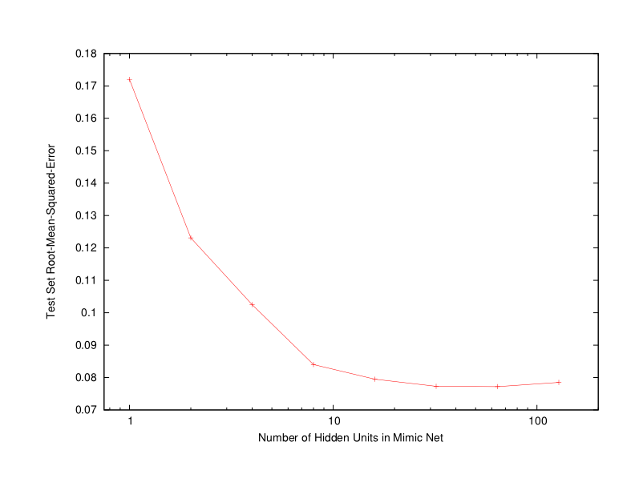
Compression Results
best “vanilla” neural net
ensemble selection target

Slide 45
Summary of Compression Results
 | ENSEMBLE | MIMIC NN | RATIO
RMSE | 0.263 | 0.264 | 0.97
Size (Mb) | 550.29 | 0.33 | 2290
Time (s) | 5396.27 | 5.62 | 1306
Neural nets that mimic high performing ensembles
2000X smaller
1000X faster
Captures 97% of performance of target
Much better than any ANN we could train directly

Slide 46
Summary of Compression Results
 | ENSEMBLE | MIMIC NN | RATIO
RMSE | 0.263 | 0.264 | 0.97
Size (Mb) | 550.29 | 0.33 | 2290
Time (s) | 5396.27 | 5.62 | 1306
Neural nets that mimic high performing ensembles
on average, capture 97% performance of target model
much better than any ANN we could train directly
More than 2000 time smaller than target ensemble
More than 1000 times faster than target ensemble
Key challenge: generating synthetic data from p(x) when unlabeled data is not available

Slide 47
Why Does It Work?
Why can compression train small nets to mimic complex models when we couldn’t train small nets on original data?
no extra labeled data
can make synthetic training set arbitrarily large so backprop doesn’t overfit
censors bad data (wrong labels)?
censors hard-to-learn data?
function is “learning friendly”
was learned by another model
does not depend on features no available as inputs
soft targets easier to learn from without overfitting than hard 0/1 targets
smooth, continuous decision boundary
gives student valuable extra multitask information (Hinton’s “Dark Knowledge”)
Notes:
Less complex models
500 points enough

Slide 48
Model compression “trick” now used to compress Very Large DNNs and ensembles of Very Large DNNs
to medium-size DNNs for use on servers
to “small” DNNs for use on smart phones
to very small DNNs/SNNs for ubiquitous recognition
Hinton calls this “distillation” and emphasizes use of soft targets to elicit “dark knowledge”
Surprise: more accurate to train “smaller” DNNs to mimic larger DNN than train on original data

Slide 49
Model Compression (Bucila, Caruana & Niculescu 2006)
Train smaller model to mimic a larger, smarter model
train smart model anyway you want:
DNN, CNN, or ensemble of CNNs
pass large unlabeled data through model to collect predictions (capture the function learned by smart model)
train “small” model to mimic large model on labeled data

Slide 50
Model Compression (prior work)
best “vanilla” neural net
ensemble selection target
(from Bucila, Caruana & Niculescu 2006)

Slide 51
Model Compression
Why can compression train small model to mimic large model when small model couldn’t be learned directly?
might have very large training set for the compression model
censors bad data (wrong labels)?
censors hard-to-learn data?
function is “learning” friendly
was learned/learnable by another model
does not depend on features not available as inputs
soft targets easier to learn than hard 0/1 targets
smooth, continuous decision boundary

Slide 52
Back to the present: How to train a Shallow NN to be as accurate as a state-of-the-art Deep NN/Conv NN
Model Compression --- unlabeled data?
Speed-up SNN learning via re-parameterization
Ensembles of CNNs

Slide 53
Unlabeled data?
Unfortunately no extra unlabeled data for TIMIT, we have to synthesize unlabeled data
Structured distortion: shift formant of the speakers
Shift formant using {+/- 1, +/- 2, +/- 3} semitones
7.7M frames augmented dataset (1.1M + 6.6M)

Slide 54
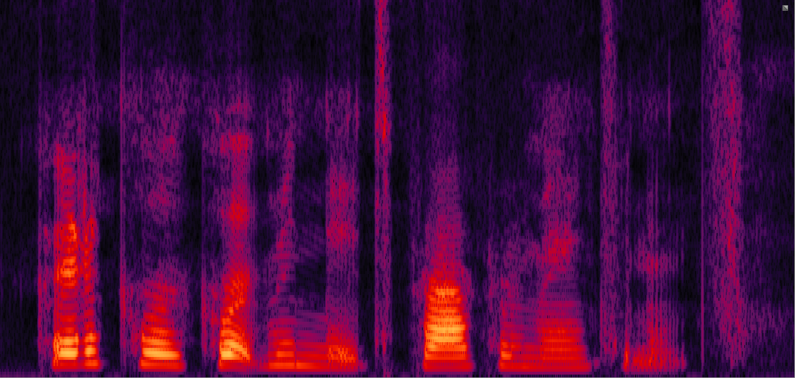
Unlabeled data?
Unfortunately no extra unlabeled data for TIMIT, we have to synthesize unlabeled data
Structured distortion: shift formant of the speakers
Shift formant using {+/- 1, +/- 2, +/- 3} semitones
7.7M frames augmented dataset (1.1M + 6.6M)

Slide 55
Unlabeled data?
Unfortunately synthetic unlabeled data doesn’t help much
Small gain in accuracy not worth the extra confusion

Slide 56
Unlabeled data?
Unfortunately synthetic unlabeled data doesn’t help much
Small gain in accuracy not worth the extra confusion

Slide 57
Unlabeled data?
No unlabeled data for TIMIT, so what do we do?
Going to do something crazy…
Use 1.1M train set as unlabeled data
throw away original “correct” labeles
replace with soft targets from deep model
train student to mimic deep teacher model
no extra unlabeled data for following TIMIT results
this makes model compression less accurate
we’ll use trickery to overcome some of the accuracy loss

Slide 58
How to train a Shallow NN to be as accurate as a state-of-the-art Deep NN/Conv NN
Model Compression --- regression, but to what targets?
Speed-up SNN learning via re-parameterization
Ensembles of CNNs

Slide 59
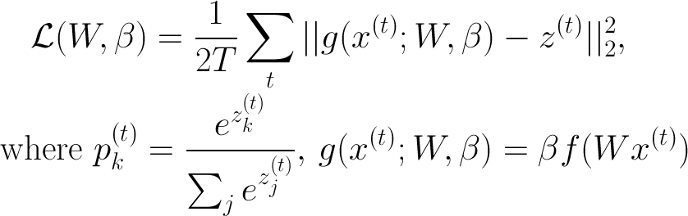
Log probability objective function for compression mimic learning
convert original softmax 0/1 ⇒ regression with L2-loss on unnormalized log probabilities (logits*)
*similar to temperature parameter in Hinton’s recent “Dark Knowledge” work

Slide 60
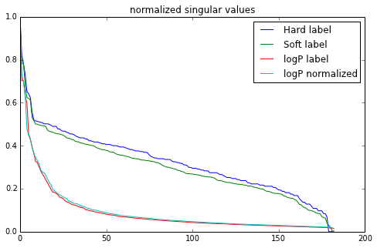
Objective function*
Make learning even easier by normalizing the targets*
sorry, don’t have hard numbers on this yet

Slide 61
Results on TIMIT

Slide 62
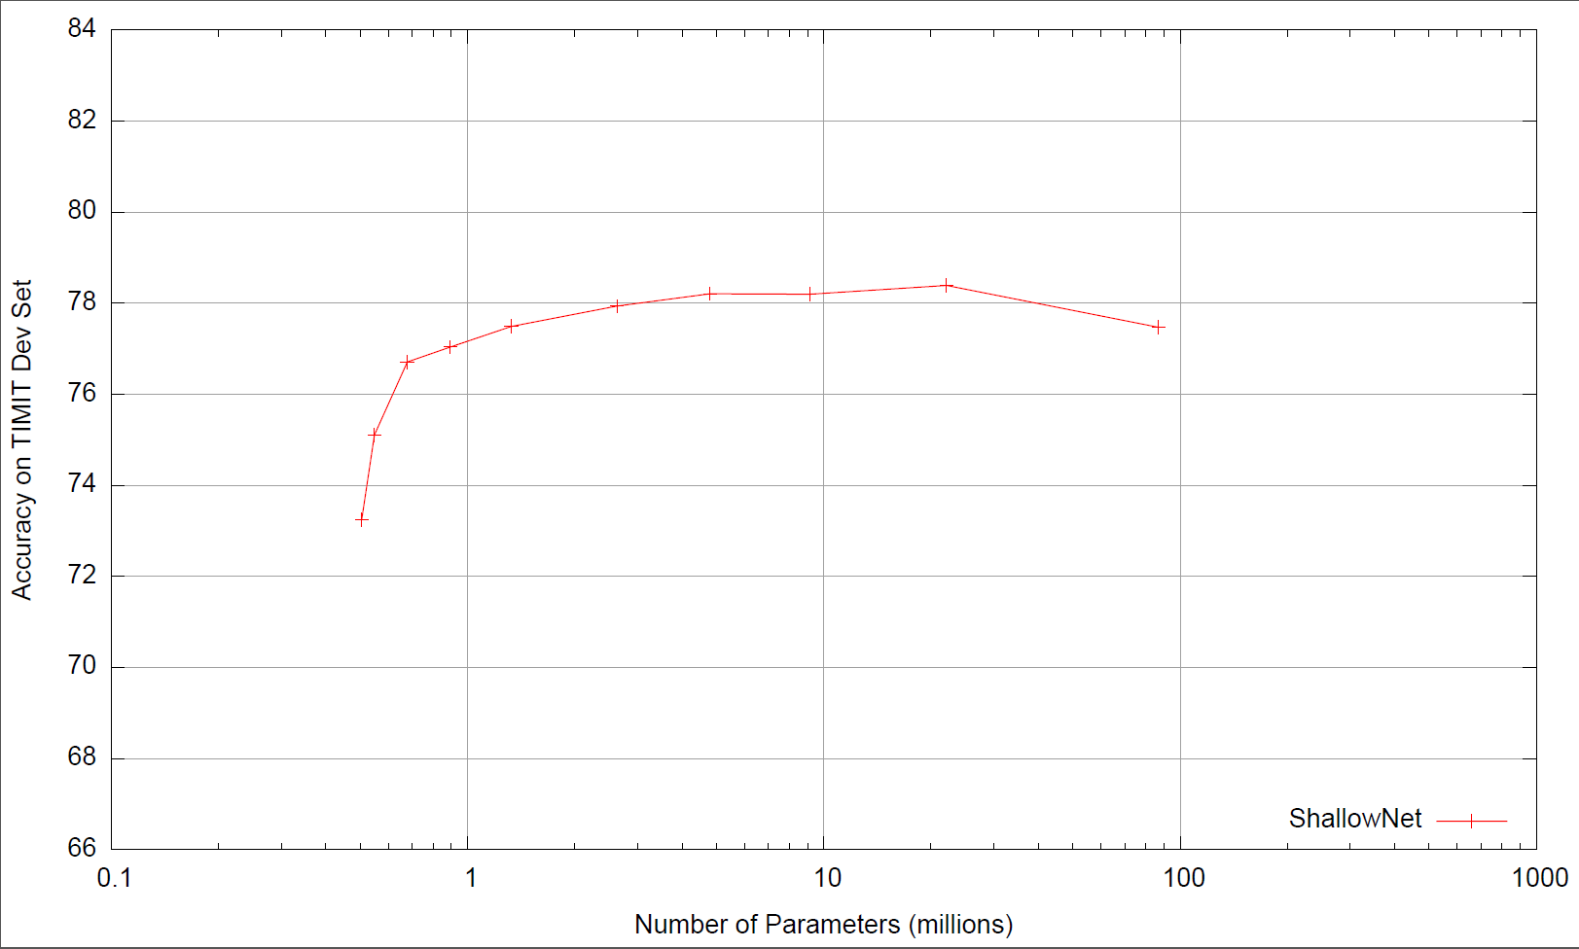

Slide 63
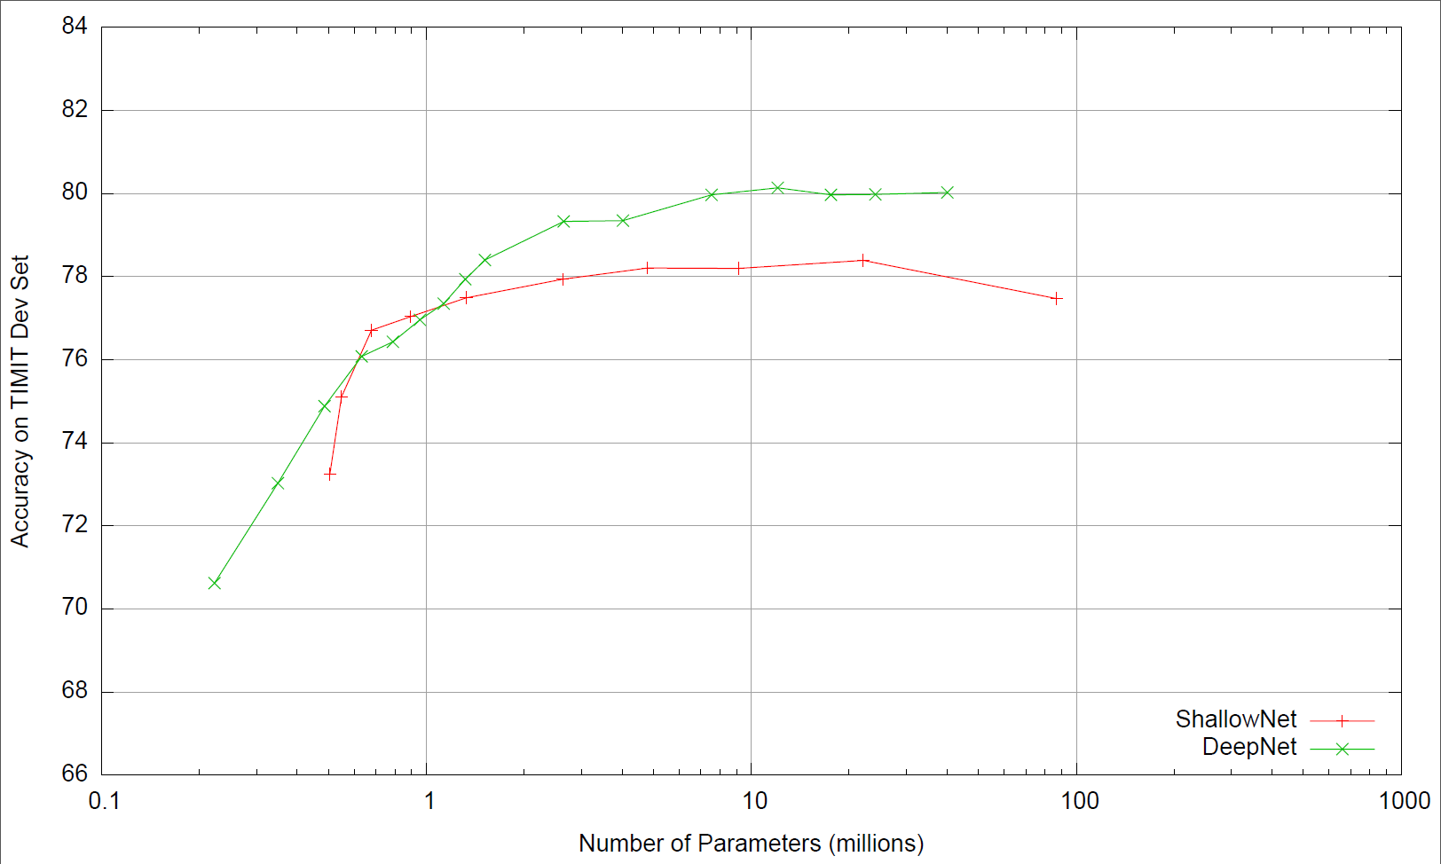

Slide 64
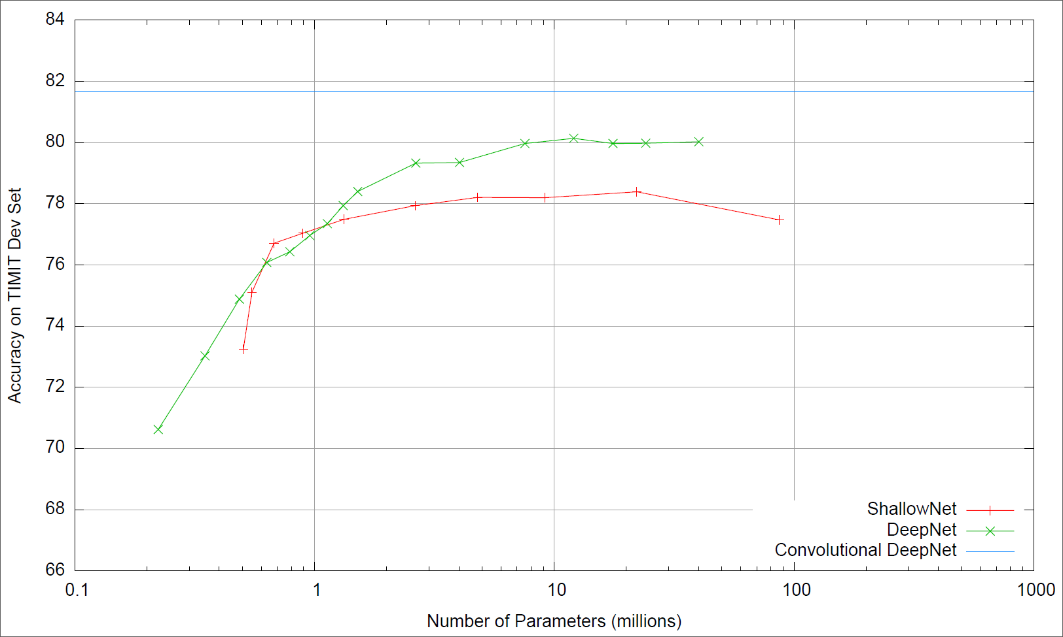

Slide 65
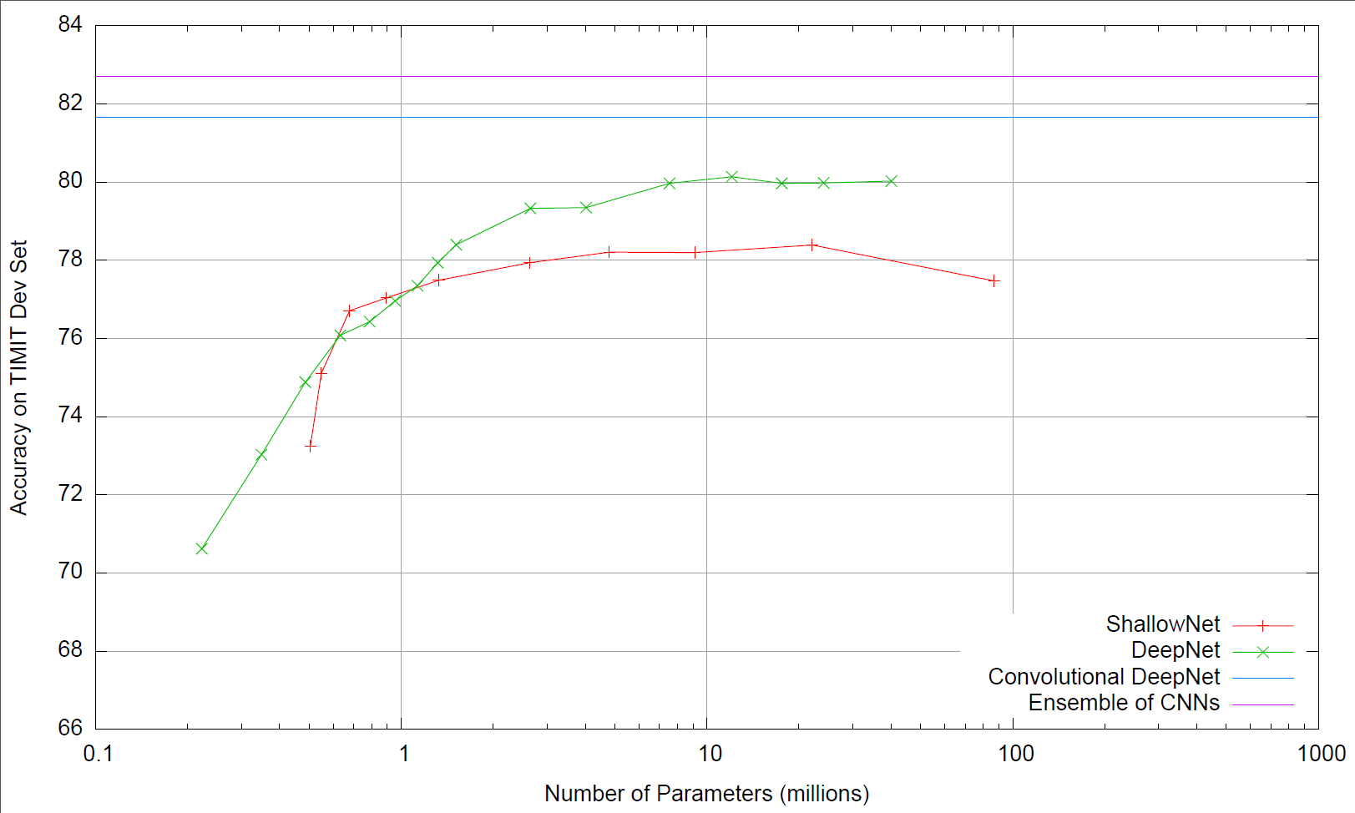

Slide 66
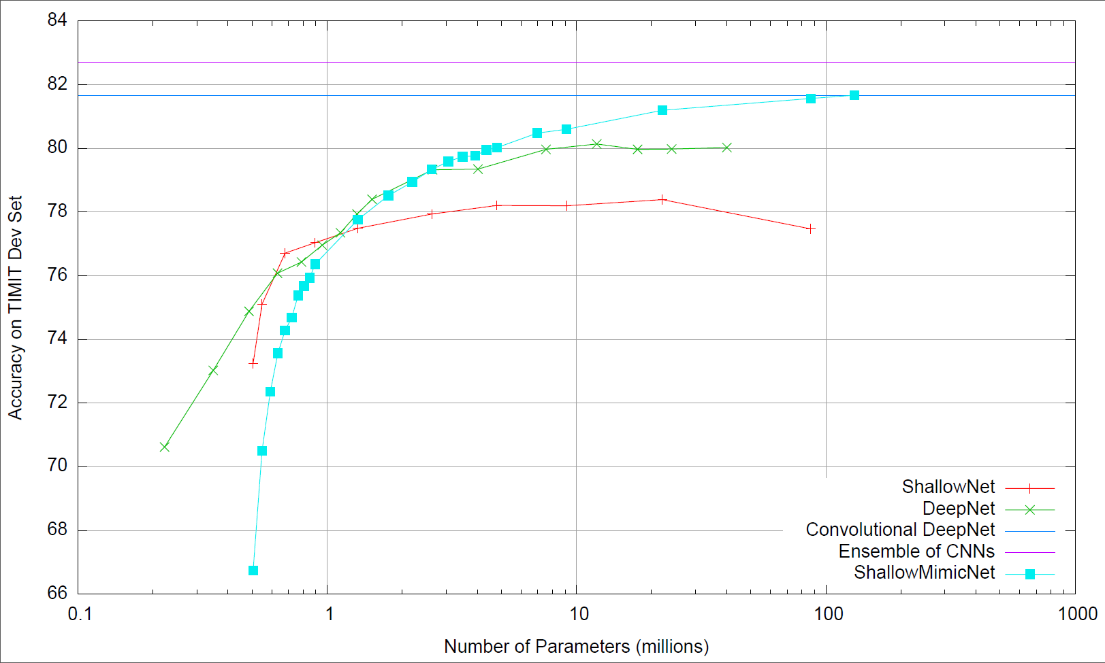

Slide 67
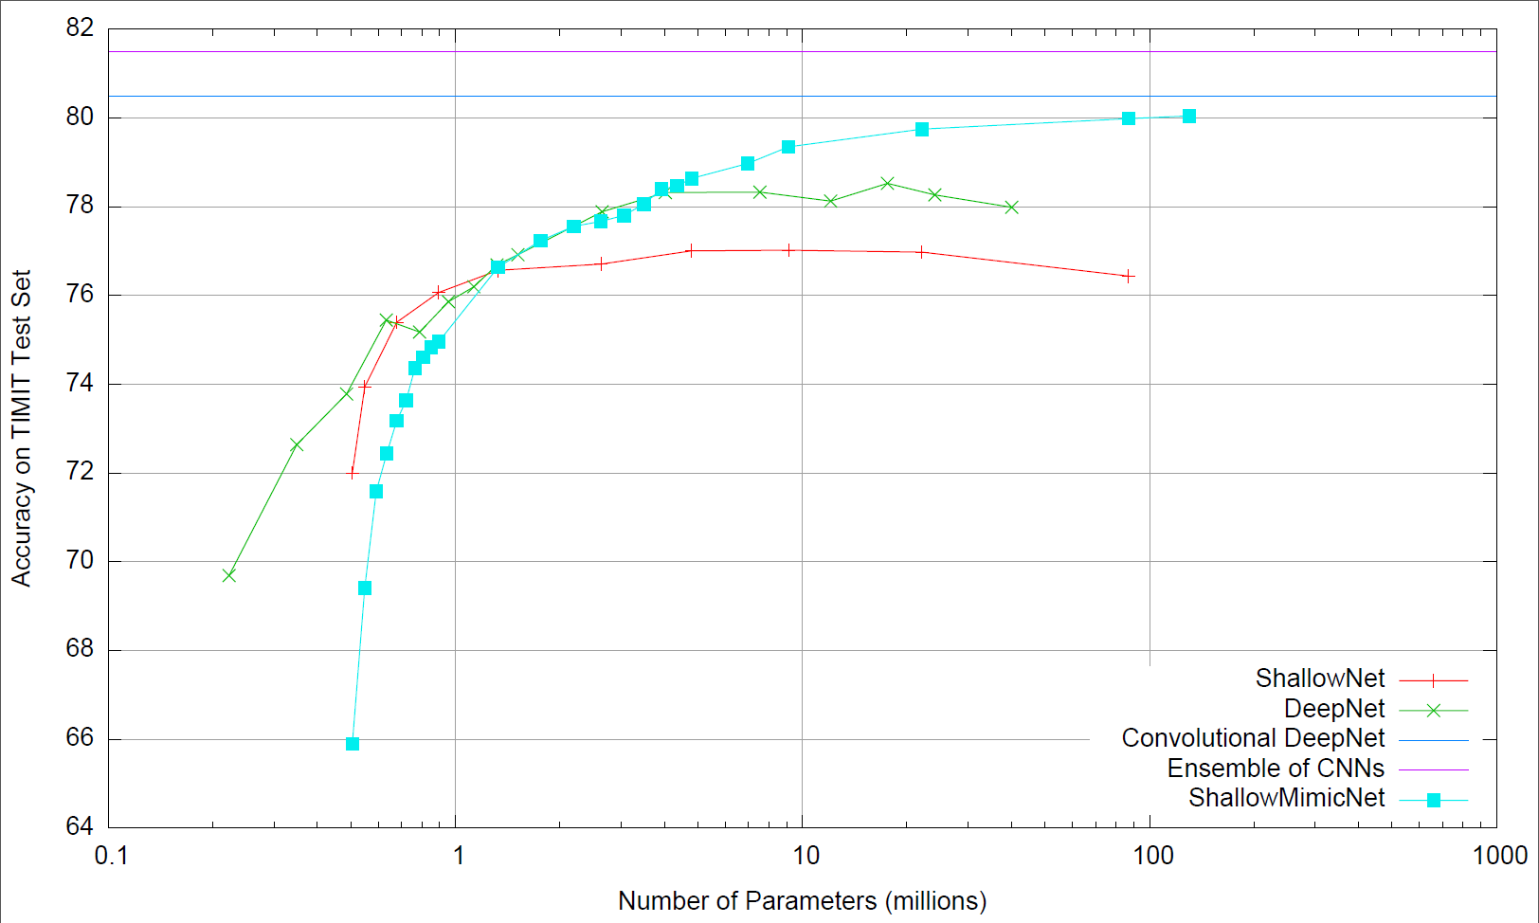
Development Set Test Set

Slide 68
So Why Does It Work?
Why can compression train small nets to mimic complex models when we couldn’t train small nets on original data?
no extra labeled data, but
can make synthetic training set arbitrarily large so backprop doesn’t overfit
censors bad data (wrong labels)?
censors hard-to-learn data?
function is “learning friendly”
was learned by another model
does not depend on features no available as inputs
soft targets easier to learn from without overfitting than hard 0/1 targets
smooth, continuous decision boundary
gives student valuable extra multitask information (Hinton’s “Dark Knowledge”)
Notes:
Less complex models
500 points enough

Slide 69

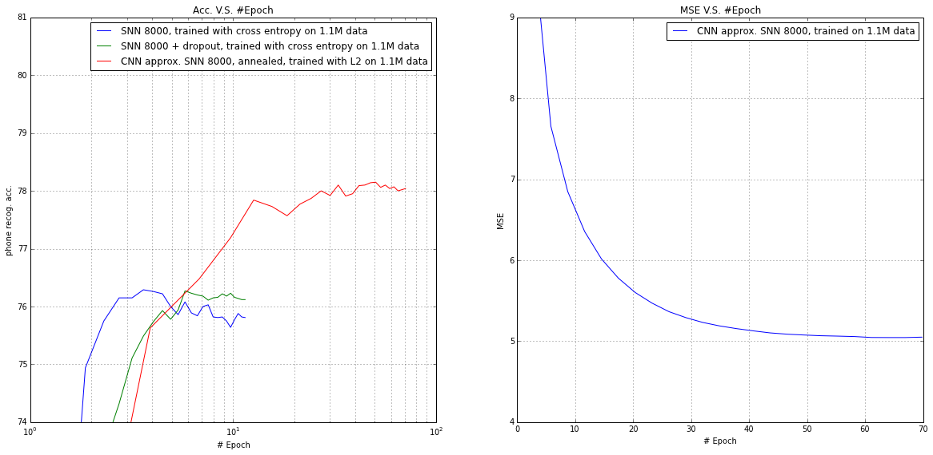
Little or no regularization needed to prevent overfitting when mimic is trained on logP with squared error

Slide 70
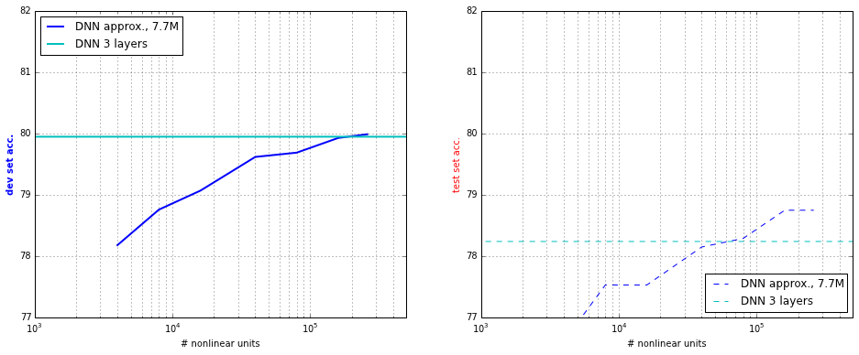
Training mimic SNNs on DNN teacher
accuracy of SNN-mimic as model complexity increases:
Development Set (50) Test Set (24)
Notes:
in the following figure, we plotted # hidden units on X-axis against the phone recognition accuracy

Slide 71
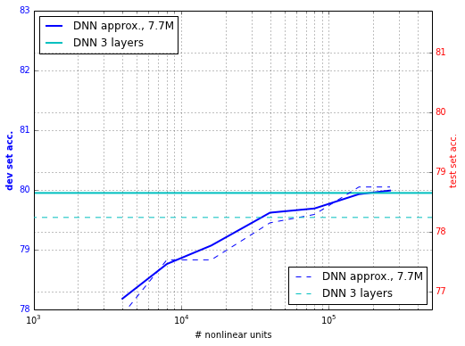
Training mimic SNNs on DNN teacher
accuracy of SNNs as model complexity increases:

Slide 72
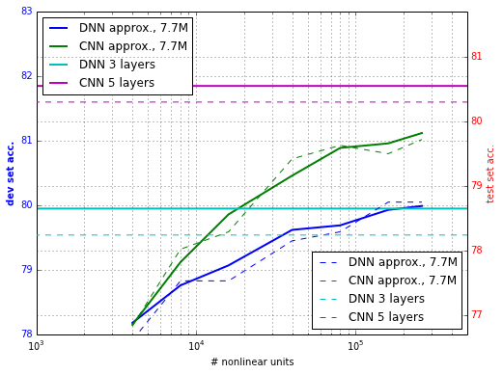
Training mimic SNNs on better CNN teacher
Complex, well-engineered architecture that is the state of the art:
Better teacher boosts the performance of the students

Slide 73
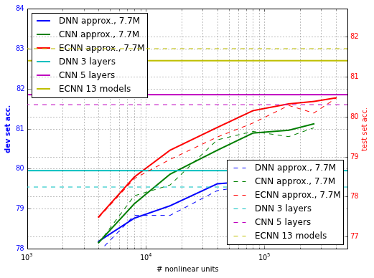
Training mimic SNNs on Ensemble of CNNs
An ensemble of 13 deep CNNs
Able to train small SNNs as accurate as DNN!
Able to train large SNNs as accurate as CNN!

Slide 74
Key observations
Little or no regularization needed to prevent overfitting when mimic is trained on logP with squared error

Slide 75
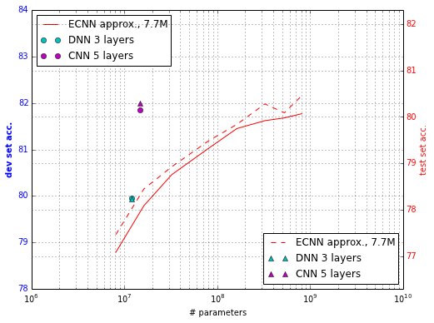
Key observations
SNN is able to approximate a DNN with comparable # parameters
SNN can reach the performance of CNN with increasing # hidden units

Slide 76
Key observations
SNN-mimic is able to approximate a Deep Neural Net given a comparable # parameters
SNN-mimic can reach performance of a Deep Convolutional Neural Net with increased # hidden units

Slide 77
How to train a Shallow NN to be as accurate as a state-of-the-art Deep NN/Conv NN
Model Compression
Speed-up SNN learning via re-parameterization
Ensembles of CNNs

Slide 78
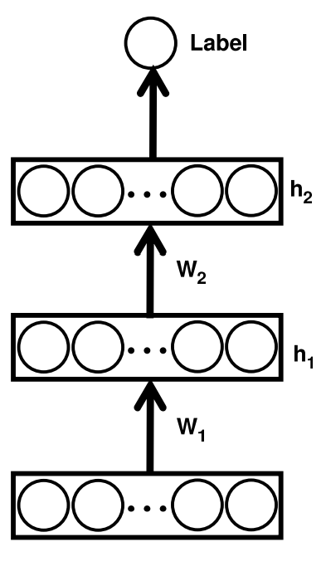
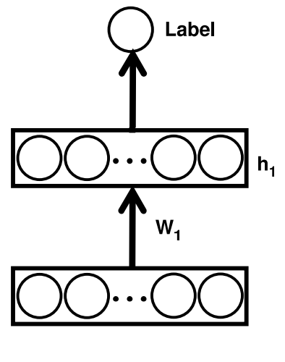
Speed up learning via linear re-parameterization
Introduce a linear bottleneck between input and hidden layer
no additional representational power
fewer parameters (low-rank)
linear units

Slide 79
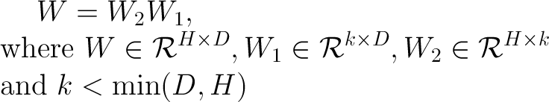
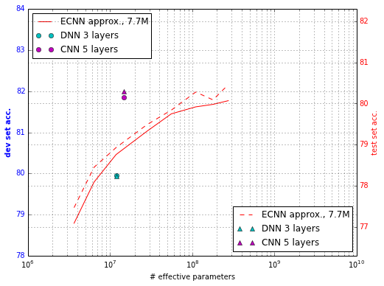
Speed up learning via linear re-parameterization
Low rank constraint on the weight matrix
Reduces the number of parameters

Slide 80
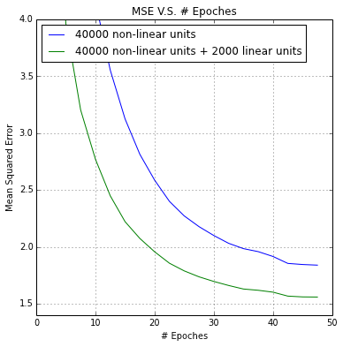
Most importantly, linear re-parameterization speeds up learning
Empirically, we observe a 2X-10X speedup in training on the squared error objective function

Slide 81
How to train a Shallow NN to be as accurate as a state-of-the-art Deep NN/Conv NN
Model Compression
Speed-up SNN learning via re-parameterization
Ensembles of CNNs

Slide 82
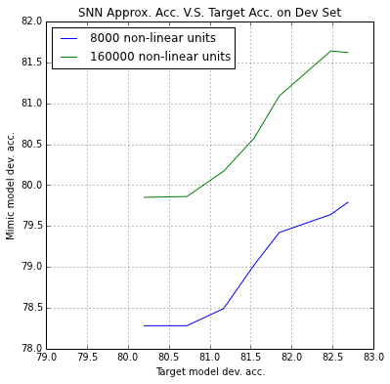
More accurate teacher -> more accurate student SNN?
Student matches teacher?

Slide 83
More accurate teacher -> more accurate student SNN?
Student matches teacher

Slide 84
More accurate teacher -> more accurate student SNN?
Fixed gap between student and teacher

Slide 85
More accurate teacher -> more accurate student SNN?
Gap between student and teacher widens as teacher gets better

Slide 86
More accurate teacher -> more accurate student SNN?
As the accuracy of the teacher increases, the same student (same model complexity) performs better:

Slide 87
Summary
Deep nets don’t need to be deep
We can make smaller, shallower nets as accurate as deep nets…
…at least on TIMIT

Slide 88
Summary
Deep nets don’t really need to be deep
We can make smaller, shallower nets as accurate as deep nets…
Qualitatively similar results on CIFAR-10
Model | 2-layer SNN | 30k SNN pretraining + dropout | CNN 3 convolutional 3 non-linear | C-SNN++
CIFAR-10 Test-Set Error Rate | 57.8% | 21.8% | 15.1% | 15.4% 15.1% 14.2%

Slide 89
Qualitatively similar results on CIFAR-10
but need to have at least 1 convolutional layer
and best results with more than 1 convolutional layer
(can’t compress convolutional layers as much)
Model | 2-layer SNN | 30k SNN pretraining + dropout | CNN 3 convolutional 3 non-linear | C-SNN++
CIFAR-10 Test-Set Error Rate | 57.8% | 21.8% | 15.1% | 15.4% 15.1% 14.2%

Slide 90
Summary of: “Do Deep Nets Really Need To Be Deep?”
Deep learning currently needed to learn accurate models that generalize well
Better inductive bias?
Better regularization? More robust to overfitting?
Better match to current training algorithms?
But deep models are not needed to represent these accurate functions
Very shallow models often can represent a function with similar accuracy using a similar number of parameters
Convolution needed in shallow model if important to deep model
Works because inductive bias learned by deep model is compiled into transfer data, and this makes it hard for student to overfit
Goal of this work was not to prove deep learning is not needed
Goal was to see why deep learning is needed:
Representation or inductive bias or training algorithm or ___________ ?

Slide 91
“Modern” Deep Learning
Best deep models keep getting deeper!

Slide 92
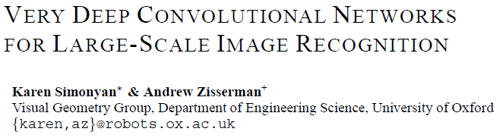
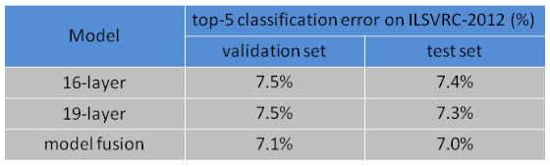
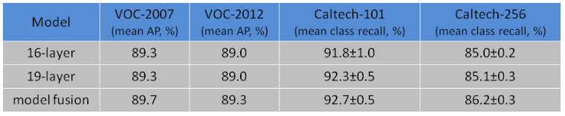

Slide 93
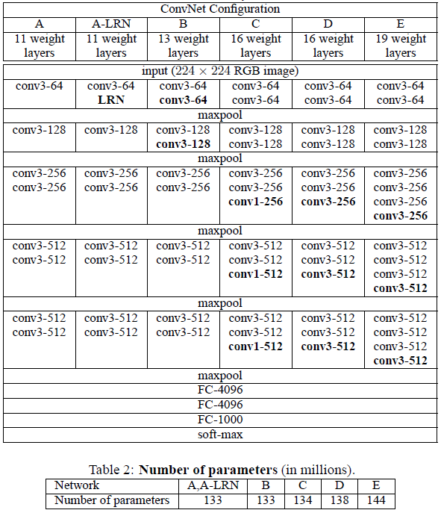

Slide 94
“Modern” Deep Learning
Best deep models keep getting deeper!
Deep models are high variance => ensembles of deep models more accurate
Most accurate deep models quickly get too big to use in practice
can’t afford to run them on servers
Can Model Compression Help?
Yes, best way to train an accurate medium-size deep model is to 1st train a very accurate extremely large deep model (or ensemble of deep models), then train medium-size deep model to mimic this larger model
true even when near-infinite train data is available!!!???

Slide 95
Results on MS Speech Recognition Model
Jinyu Li, Rui Zhao, Jui-Ting Huang, and Yifan Gong Microsoft
30 million parameters in large teacher deep model
Only 2 Million parameter in small student deep model
Accuracy
Teacher DNN trained with standard 0/1 labels
Student DNN trained with more advanced techniques
Student DNN trained with simple mimicry
Small-size DNN trained with standard 0/1 labels

Slide 96
Summary
Not trying to replace deep neural nets with shallow 1-layer nets
SNN can learn similar function and achieve comparable performance to DNN with same # parameters
Large SNN (~200k non-linear hidden units) approaches the state of the art of CNN models (without convolution)
Algorithm is ugly --- have to train DNN, CNN, or ensemble of CNNs, then mimic it --- is there a “nice” algorithm that can train accurate SNNs from original labels on original train data?
Training smaller models to mimic very accurate, very large models is useful for delivering high accuracy at run-time with reduced memory and computational power reqmts
Train medium DNNs for speech recognition on servers
Train small DNNs for speech recognition on smartphones
Clearly large/deep/complex/ensemble ≠ complex function
Currently need large models for training (inductive bias, prior, overfitting prevention), but not for representation
Notes:
The results given here provide

Slide 97
Future directions
Why does model compression work?
Does this still work on deeper models --- how much can we compress depth of very large models (e.g. ImageNet)?
How compressible are convolutional layers?
How compressible are fully-connected non-linear layers?
Find algorithm to train SNN on original data?

Slide 98
Summary
SNN can learn similar function and achieve comparable performance to DNN with same # parameters!
Large SNN (~200k non-linear hidden units) approaches the state of the art of CNN models (without convolution)!
Our algorithm is ugly --- still have to train DNN, CNN, or ensemble of CNNs, then mimic it, but there should be a “nice” algorithm that can train accurate SNNs from original labels on train data?
New high-water mark on TIMIT with ensembles
Training smaller models to mimic very accurate, very large models is useful for delivering high accuracy at run-time with reduced memory and computational power reqmts
Train medium DNNs for speech recognition on servers
Train small DNNs for speech recognition on smartphones
Clearly large/deep/complex/ensemble ≠ complex function
Currently need large models for training (inductive bias, prior, overfitting prevention), but not for representation
Notes:
The results given here provide

Slide 99
Future directions
Find elegant algorithm to train SNN from original data?
Does this still work on deeper models --- how much can we compress depth of very large models?
Why does the linear layer speed up learning so much?
How compressible are convolutional layers?
How compressible are fully-connected non-linear layers?
How best to train medium-size deep models to mimic very large very deep models?

Slide 100
A Brief History of Model Compression/Mimicry
TREPAN [Craven & Shavlik, 1996]
Extract tree-structured representations from neural nets
CMM (Combine Multiple Models) [Domingos, 1997]
Improve accuracy of C4.5 rules without losing intelligibility
Train C4.5 to mimic ensemble of C4.5 rules
Method for generating extra data specific for C4.5 rules
Neural Nets Approximator [Zeng & Martinez, 2000]
Trained neural net to mimic ensemble of neural nets
Model Compression [Bucia, Caruana & Niculescu, 2005]
Trained small nets to mimic large heterogeneous ensembles
Do Deep Nets Really Need To Be Deep? [Ba & Caruana, 2013/14]
Trained shallow nets to mimic deep nets
Model Distillation and Dark Knowledge [Hinton, Vinyals & Dean, 2014/15]
Model compression with emphasis on importance of logits
FitNets: Hints for Thin Deep Nets [Ramiro, Ballas, Kahou, Chassang, Gatta, Y.Bengio, 2015]
Training fast, very thin, very deep DNNs to be more accurate than teacher

Slide 101
Other Uses of Model Compression/Mimicry
TREPAN [Craven & Shavlik, 1996]
Extract tree-structured representations from neural nets
Neural nets are difficult to understand, but trees that mimic them are not!

Slide 102
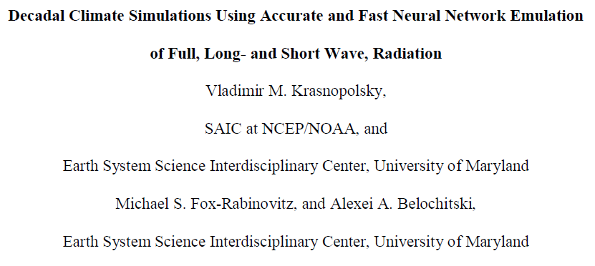
Other Uses of Model Compression/Mimicry

Slide 103
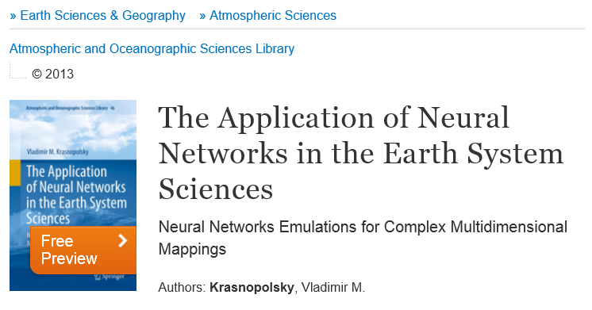
Other Uses of Model Compression/Mimicry

Slide 104
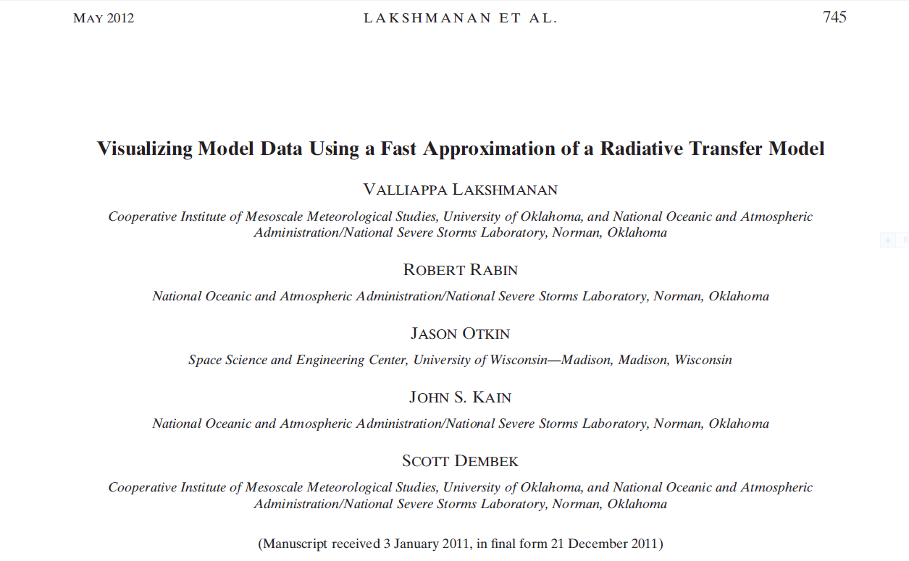
Other Uses of Model Compression/Mimicry

Slide 105
Related Work
TREPAN [Craven and Shavlik, 1996]
Extract tree-structured representations from neural nets
Reduced-Set SVMs (prune support vectors) [Burges, 1996]
CMM (Combine Multiple Models) [Domingos, 1997]
Improve accuracy of C4.5 rules without losing intelligibility
Train C4.5 to mimic ensemble of C4.5 rules
Method for generating extra data specific for C4.5 rules
Neural Nets Approximator [Zeng and Martinez, 2000]
Trained neural net to model ensemble of neural nets
Pruning adaptive boosting [Margineantu and Dietterich 2000]
To compress ensemble, prune away some of the models
Image Recognition via Boosted Cascades [Viola, 2001]
DECORATE: Improve model diversity [Melville and Mooney, 2003]
Hinton’s recent work

Slide 106
Special thanks to:
Li Deng for help with TIMIT and CDNN
John Platt, Chris Burges, David Johnson for discussion
Mike Aultman, Ahmad Abdulkader, Ofer Dekel, Paul Koch for help with computational resources
Samira Kahou intern working to improve CIFAR-10 results

Slide 107
Summary
Deep learning is magic in some domains
Currently, models need to be deep to learn high-accuracy models
But functions learned by deep models often can be compressed into smaller (and sometimes shallower) neural nets
Dream LARGE: don’t be afraid of large models because we can often make them smaller and faster for run-time
We still don’t really know why deep learning works…

Slide 108
Thanks!

